Slide 1
Sales and Customer Insights Dashboards
File created on: 7/20/2024 1:16:16 PM

Slide 2
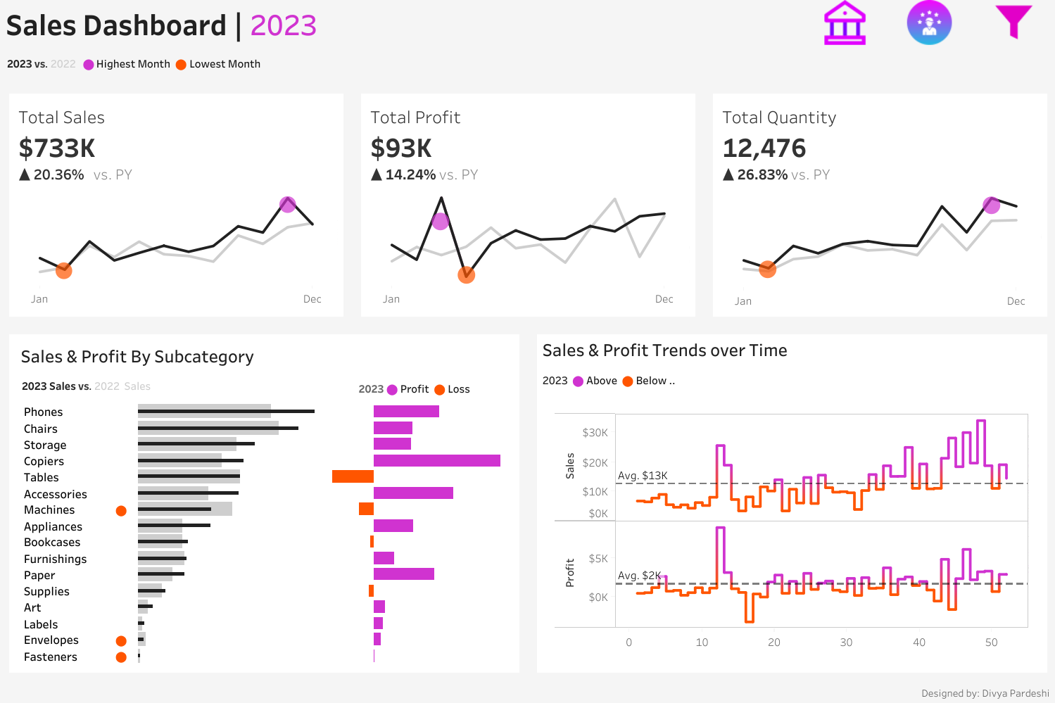

Slide 3
